Slide 1
Introduction to
Distributed Systems
Slides for CSCI 3171 Lectures
E. W. Grundke

Slide 2
References
D. E. Comer
Computer Networks and Internets, 3rd ed.
(Chapter 35: RPC and Middleware)
Prentice-Hall 2001
A. Tanenbaum and M. van Steen (TvS)
Distributed Systems: Principles and Paradigms
Prentice-Hall 2002
G. Coulouris, J. Dollimore and T. Kindberg (CDK)
Distributed System: Concepts and Design
Addison-Wesley 2001

Slide 3
Acknowledgement
Some slides from:
TvS: http://www.prenhall.com/divisions/esm/app/author_tanenbaum/custom/dist_sys_1e/
CDK: http://www.cdk3.net/ig/beida/index.html

Slide 4
Middleware is…
‘The role of middleware is to ease the task of designing, programming and managing distributed applications by providing a simple, consistent and integrated distributed programming environment.
Essentially, middleware is a distributed software layer, or “platform” which abstracts over the complexity and heterogeneity of the underlying distributed environment with its multitude of network technologies, machine architectures, operating systems and programming languages.’
— IEEE Distributed Systems Online
<http://dsonline.computer.org/middleware/>

Slide 5
Remote Procedure Calls
(RPC)

Slide 6
Motivation
Writing clients and servers is error-prone (certainly in C!)
(much low-level detail, yet common basic patterns)
Instead:
  hide communications behind a ‘function call’
  specify a high-level interface only
  use an automated tool to generate the actual client/server code
Advantage:
  focus programmer attention on the application, not on the communications
  familiar function-calling paradigm

Slide 7
What is RPC?
Call a procedure (function, subroutine, method, …)
in a program
running on a remote machine,
while hiding communication details from the programmer.
Note: Think C, not java! We deal with objects later!

Slide 8
Standards for RPC
RFC 1057: Remote Procedure Call
RFC 1014: External Data Representation
Author: Sun Microsystems Inc.
Others: see Comer.
Sun RPC Demo with the rpcgen tool:
http://www.eng.auburn.edu/department/cse/classes/cse605/examples/rpc/stevens/SUNrpc.html
20 Oct 2002 archived copy

Slide 9
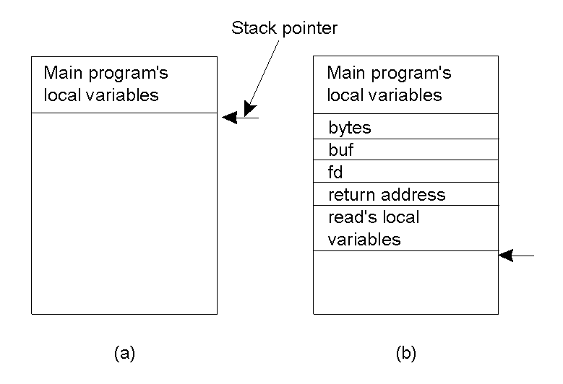
Conventional Procedure Call
Parameter passing in a local procedure call: the stack before the call to read
The stack while the called procedure is active
TvS 2.7

Slide 10
Conventional Parameter Passing Techniques
Call-by-value
Call-by-reference
Call-by-copy/restore

Slide 11
Complications for Remote Calls
How to make it look like a function call, but actually use a client and server?
Answer: use ‘stubs’ (‘proxies’)
How to handle parameters and return values?
  Platform differences (e.g. endian issues)
  Pass-by-reference
Answer: use ‘external data representation’

Slide 12
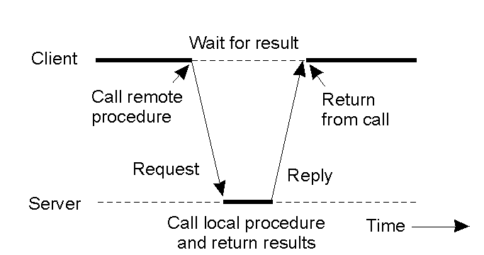
Timing (Synchronous RPC)
RPC between a client and server program.
TvS 2.8

Slide 13
Steps of a Remote Procedure Call
Client procedure calls client stub in normal way
Client stub builds message, calls local OS
Client's OS sends message to remote OS
Remote OS gives message to server stub
Server stub unpacks parameters, calls server
Server does work, returns result to the stub
Server stub packs it in message, calls local OS
Server's OS sends message to client's OS
Client's OS gives message to client stub
Stub unpacks result, returns to client
TvS 2.9

Slide 14
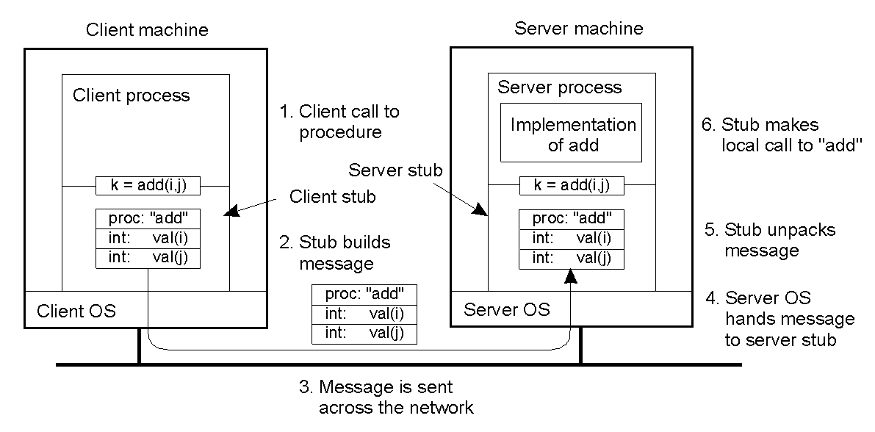
Passing Value Parameters
Steps involved in doing remote computation through RPC
2-8
TvS 2.10

Slide 15
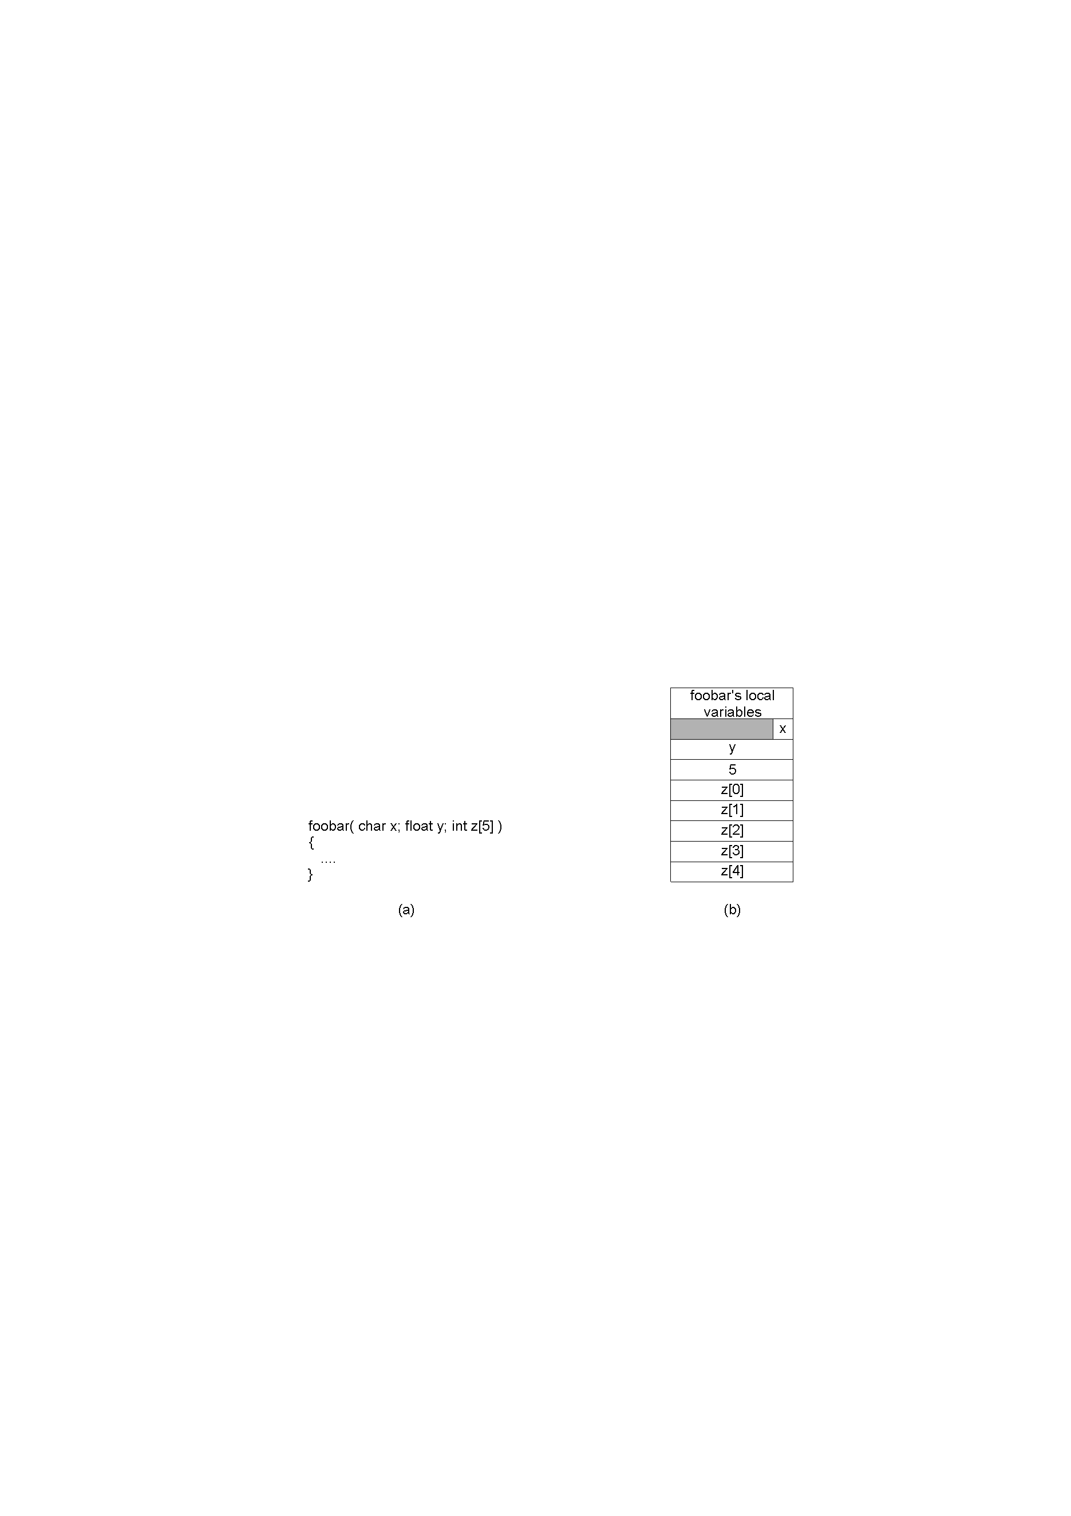
Parameter Specification and Stub Generation
A procedure
The corresponding message.
TvS 2.12

Slide 16
Passing Reference Parameters
Reference variables (pointers):
pointers to arrays
pointers to structures (objects without methods)
What if the structure contains other pointers?
The server may need a whole ‘graph’ of structures!
‘Parameter marshalling’

Slide 17
Interface Definition Language (IDL)
Specifies an interface
  types
  constants
  procedures
  parameter data types
Does not specify an implementation
Compiled into client and server stubs

Slide 18
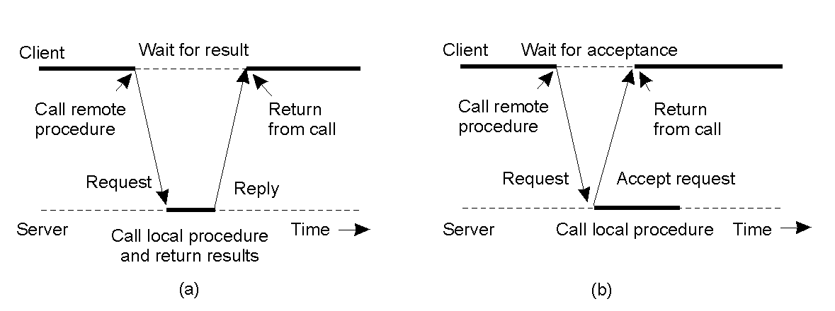
Asynchronous RPC
2-12
The interconnection between client and server in a traditional RPC
The interaction using asynchronous RPC
TvS 2.14

Slide 19
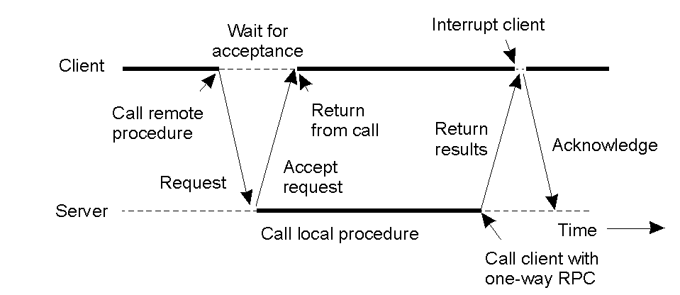
Asynchronous RPC:
Deferred Synchronous RPC
A client and server interacting through two asynchronous RPCs
TvS 2.15

Slide 20
Distributed Computing Environment (DCE)
A middleware system
Developed by The Open Group (previously OSF)
Includes
  distributed file service
  directory service
  security service
  distributed time service
Adopted by Microsoft for distributed computing

Slide 21
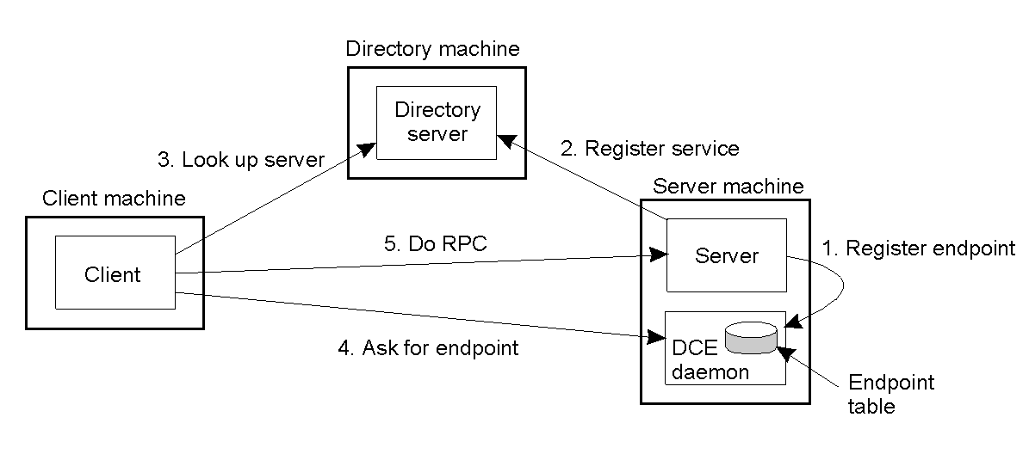
DCE: Binding a Client to a Server
2-15
TvS 2.17

Slide 22
External Data Representation

Slide 23
Motivation
Data in running programs:
Not just primitives, but
arrays, pointers, lists, trees, etc.
In general:
complex graphs of interconnected structures or objects
Data being transmitted:
Sequential!
Pointers make no sense.
Structures must be flattened.
All the heterogeneities must be hidden!
(endian, binary formats, etc.)
CDK 4.3

Slide 24
What is an External Data Representation?
‘An agreed standard for the representation of data structures and primitive values.’
Internal to external: ‘marshalling’
External to internal: ‘unmarshalling’
Examples:
Sun XDR
CORBA’s Common Data Representation (CDR)
Java Object Serialization

Slide 25
CORBA CDR
Defined in CORBA 2.0 in 1998
Primitive types:
Standard data types, both big/little endian, conversion by the receiver.
Constructed types:
sequence, string, array, struct, enumerated, union
(not objects)
Data types are not specified in the external format: receiver is assumed to have access to the definition (via IDL).
(unlike Java Object Serialization!)
CDK 4.3

Slide 26
CORBA CDR Example
Index in sequence 4 bytes wide Notes
of bytes
0-3
5
Length of string
4-7
”Smit”
“Smith”
8-11
”h____”
12-15
6
Length of string
16-19
”Lond”
“London”
20-23
”on__”
24-27
1934
Unsigned long
The flattened form represents a Person struct with value:
{”Smith”, ”London”, 1934}
CDK 4.3

